Slide 1


Noida Institute of Engineering and Technology, Greater Noida
Problem solving using Advanced Python
(ACSE0101/AMICSE0101)
UNIT-IV
GUI Programming
CSE Department
B. Tech Second Semester
(Common to multiple branches)

Slide 2
Index
Course Outcomes
Syllabus
Contents of the Unit
Objectives of the Unit
CO- PO correlation w.r.t. Unit
CO-PSO correlation w.r.t. Unit
Prerequisite and Recap
Objectives of the topic
Topic mapping with CO
Video Links
Daily Quiz
MCQs
Weekly assignment
Old University Exam Paper
Expected Questions for University Exams
Summary
References

Slide 3
Course Outcome
Course Outcome ( CO) | At the end of course , the student will be able to: | Bloom’s Knowledge Level (KL)
CO1 | Define classes and create instances in python. | K1, K2
CO2 | Implement concept of inheritance and polymorphism using python. | K3
CO3 | Implement functional programming in python. | K2
CO4 | Create GUI based Python application. | K3
CO5 | Apply the concept of Python libraries to solve real world problems. | K3, K6

Slide 4
Syllabus
UNIT-4
GUI Programming
Ipywidgets Package, Numeric Widgets, Boolean Widgets, Selection Widgets, String Widgets, Date Picker, Color Picker, Container Widgets, Creating a GUI Application, Tkinter, button, canvas.

Slide 5
Contents of the Unit
Ipy widgets Package
Numeric Widgets
Boolean Widgets
Selection Widgets
String Widgets
Date Picker
Color Picker
Container Widgets
Creating a GUI Application

Slide 6
Objectives of the Unit
After completion of the Unit, student will be able to:
Create Graphical User Interface for applications
Understand the use of different type of Widgets
Understand how to use widgets

Slide 7
CO-PO Correlation Matrix
CO.K | PO1 | PO2 | PO3 | PO4 | PO5 | PO6 | PO7 | PO8 | PO9 | PO10 | PO11 | PO12
CO1 | 3 | 3 | 3 | 3 | 2 | 2 | 1 | - | 1 | - | 2 | 2
CO2 | 3 | 3 | 3 | 3 | 2 | 2 | 1 | - | 1 | 1 | 2 | 2
CO3 | 3 | 3 | 3 | 3 | 3 | 2 | 2 | - | 2 | 1 | 2 | 3
CO4 | 3 | 3 | 3 | 3 | 3 | 2 | 2 | 1 | 2 | 1 | 2 | 3
CO5 | 3 | 3 | 3 | 3 | 3 | 2 | 2 | 1 | 2 | 1 | 2 | 2
AVG | 3.0 | 3.0 | 3.0 | 3.0 | 2.6 | 2.0 | 1.6 | 0.4 | 1.6 | 0.8 | 2.0 | 2.4

Slide 8
CO-PSO correlation matrix
CO | PSO
 | PSO1 | PSO2 | PSO3 | PSO4
CO1 | 2 | 2 | 2 | 2
CO2 | 2 | 2 | 1 | 1
CO3 | 2 | 2 | 1 | 1
CO4 | 2 | 2 | 1 | 1
CO5 | 2 | 2 | 2 | 2
Average | 2 | 2 | 1.4 | 1.4

Slide 9
Pre-requisite and Recap
I’d just need you to open your Jupyter notebook.
Please install & import the following libraries :-
!pip install ipython from ipywidgets import widgets from IPython.display import display

Slide 10
(Ipywidgets Widgets) (CO4)
Ipywidgets Widgets
It provides various graphical user interface controls to the users for handling their data interactively
It provides interactive HTML widgets for Jupyter notebooks, JupyterLab and the Ipython kernel.
It can be created quickly
Advantages:-
This package will provide Python programmers all the standard widgets and functions to be able to control their data interactively and visualize various aspects of it.

Slide 11
Type of Ipywidgets (CO4)
The types of widgets supported by Ipywidgets library are
Numeric widgets
Boolean widgets
Selection widgets
String widgets
Data picker
Color picker
Container widgets

Slide 12
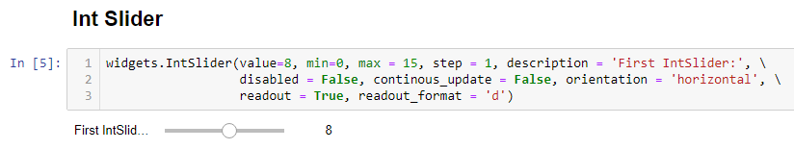
Numeric Widgets (CO4)
Numeric Widgets
Widgets exist for displaying integers and floats, both bounded and unbounded.
The integer widgets share a similar naming scheme to their floating point counterparts.

Slide 13
Numeric Widgets (CO4)
value : In the value parameter, we pass a default value to be plotted on the slider. In this case it is 8.
min : In the min parameter, we pass the the minimum value for the slider, where the slider will basically start from. In this case it is 0.
max : In the max parameter, we pass the maximum value for the slider, where the slider will basically end at. In this case it is 15.
step : In the step parameter, we pass the rate (step count) at which the slider increments on a single slide. In this case it is 1.

Slide 14
Numeric Widgets Contd…(CO4)
description : In the description parameter, we pass the string which will be the name/label given to the IntSlider widget. In this case it is ‘First IntSlider:’.
disabled : In the disabled parameter, we pass a boolean value (either True or False). By passing True, you intend to keep your widget enabled and vice versa.
continuous_update : This continuous_update parameter basically triggers a value change only when the user stops dragging a slider. You again pass a boolean value (either True or False) in this paramater. Also, please read it as continuous_update in the code snippet above and not as continous_update

Slide 15
Numeric Widgets Contd… (CO4)
orientation : In the orientation parameter, we pass either ‘horizontal’ or ‘vertical’ depending upon how do we want to align our slider on the screen. In this case, we have passed ‘horizontal’ and hence you can see the slider horizontally aligned.
readout : In the parameter readout, we pass a boolean value (either True or False). On passing True we intend to show the current value of the slider next to it and vice versa. In this case we have passed True and you can see 8 (the current value) next to the slider.

Slide 16
Numeric Widgets Contd.. (CO4)
readout_format : In the parameter readout_format, we specify the format function that is used to represent the slider value. By default, it is ‘.2f’ but you can obviously send other format functions too like ‘d’, ‘.1f’, etc. However, for IntSliders the format should be ideally ‘d’ because anyway the Slider widget will auto convert a float value to a rounded off (generally floor) int value.
The backslash (\) used at the end of each line is for line continuation for better readability. It is not an intrinsic or functional part of the code

Slide 17
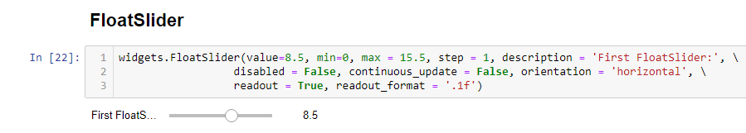
Numeric Widgets Contd…(CO4)
The paramaters are mostly the same for widgets.FloatSlider() as they are for widgets.IntSlider() .

Slide 18
Numeric Widgets Contd… (CO4)
The difference comes in the nature of numeric values that you pass to value, min, max & step parameters for instance. So the values passed to these parameters are now float as compared to int in case of the IntSlider
Also, the readout_format parameter will be passed ‘.1f’ or ‘.2f’ values, knowing that it is obviously a FloatSlider widget

Slide 19
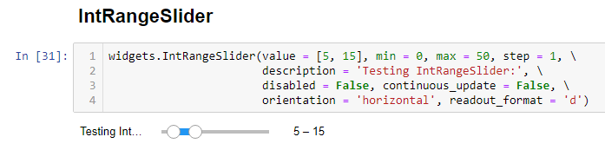
Numeric Widgets Contd..(CO4)
In this IntRangeSlider widget, the nature and list of parameters are all same as what we pass in the IntSlider, except for value.

Slide 20
In the value parameter, instead of passing a single integer value as we do in IntSlider, we will rather pass a range of values in the form [x,y] which will be plotted by default as x — y on the slider. For example in this case it is [5, 15]. so, if you’ll see in the widget that gets printed right beneath the code snippet above, the default range is selected as 5–15
Numeric Widgets Contd..(CO4)

Slide 21
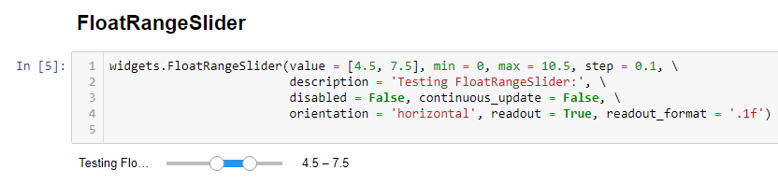
NumericWidgets Contd..(CO4)
In this FloatRangeSlider widget, the nature and the list of parameters are all same as what we pass in the FloatSlider, except for value.

Slide 22
Numeric Widgets Contd..(CO4)
In the value parameter, instead of passing a single float value as we do in FloatSlider, we will rather pass a range of float values in the form [x, y] which will be plotted by default as x — y on the slider. For example, in this case it is [4.5–7.5].
So if you’ll see in the widget that got printed right beneath the code in the snippet above, thedefault range of the slider is marked as [4.5–7.5]

Slide 23
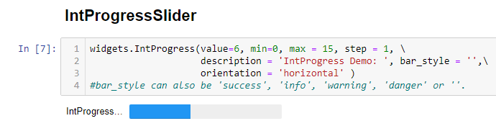
Numeric Widgets Contd..(CO4)

Slide 24
Int Progress Slider widgets are generally used to show progress of any sort. It can be a progress on the work being done, or the result being achieved, etc. Again, the nature and the list of parameters are mostly the same as what we pass in IntSlider widget, except for bar style parameter. The min and max parameters are very self explanatory and in this case have 0 and 15 as values, respectively.
Numeric Widgets Contd..(CO4)

Slide 25
Numeric Widgets(CO4)
Since, the value provided is 6, you will see that the progress slider has the progress marked till a point that prima-facie appears to be 6 on a scale of 0 to 15.
Also, in the bar_style parameter, you can pass different kind of values too, like : ‘success’, ‘warning’, ‘info’, ‘danger’, etc. With each of these values being passed, you will see the color / appearance of the progress slider getting changed, hence, fitting the requirement of different use-cases.

Slide 26
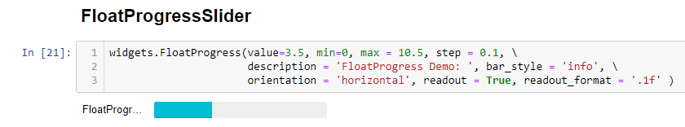
Numeric Widgets Contd..(CO4)
The parameters are mostly the same for widgets. FloatProgressSlider() as they are for widgets. IntProgressSlider() except for value and step parameters.

Slide 27
Numeric Widgets(CO4)
The value parameter in case of FloatProgressSlider is passed float values (3.5 in this case) unlike IntProgressSlider in which case we pass integer values.
The step parameter is again capable of accepting float values too in FloatProgressSlider(like 0.1 in this case). This means that the progress depicted on the FloatProgressSlider will happen at the rate of 0.1 on every step.

Slide 28
BooleanWidgets(CO4)
There are three widgets that are designed to display a Boolean value.
ToggleButton
Checkbox
Valid

Slide 29
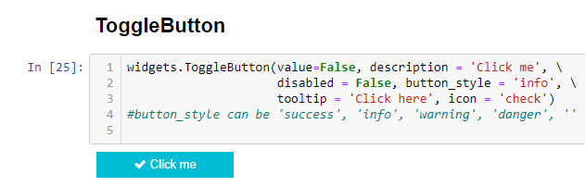
BooleanWidgets(CO4)
ToggleButton is a Boolean widget in ipywidgets which work on a very Boolean concept. We show a selectable button (for eg, labelled “Click me” in this case) to represent this widget.
The value related to this widget is True if the button is checked and it is False if the button is unchecked.

Slide 30
BooleanWidgets Contd..(CO4)
The parameters used in widgets.ToggleButton are very self explanatory, however, I shall just give a quick overview of the ones I feel you might need an explanation
The value parameter accepts either True or False as values. In case of True the button is shown auto-checked or clicked by default. And, in case of False it is shown unchecked, by default.
The tooltip parameter is passed a string value which will basically be displayed when the user hovers over the button..

Slide 31
BooleanWidgets Contd..(CO4)
The button_style & icon parameters are for changing the colors of the button and the icon shown on the button, respectively
The tooltip parameter is passed a string value which will basically be displayed when the user hovers over the button.
The button_style & icon parameters are for changing the colors of the button and the icon shown on the button, respectively.

Slide 32
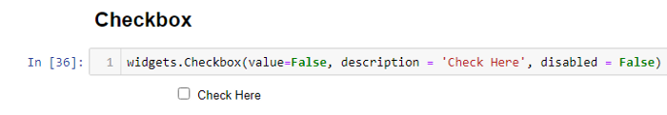
widgets.Checkbox() widget provides a very clean and crisp way to display a checkbox using very less parameters.
BooleanWidgets Contd..(CO4)

Slide 33
The value parameter accepts either True or False. The checkbox widget remains checked in case of former and unchecked in case of latter. A checked/selected Checkbox widget would mean that the value associated with the widget is True and vice-versa.
BooleanWidgets Contd..(CO4)

Slide 34
BooleanWidgets Contd..(CO4)
Valid
The valid widget provides a read-only indicator.
widgets.Valid(
value=False,
description='Valid!', )

Slide 35
There are several widgets that can be used to display single selection lists, and two that can be used to select multiple values. All inherit from the same base class. It can specify the enumeration of selectable options by passing a list (options are either (label, value) pairs, or simply values for which the labels are derived by calling str)
SelectionWidgets(CO4)

Slide 36
SelectionWidgets(CO4)
RadioButtons
widgets.RadioButtons(
options=['pepperoni', 'pineapple', 'anchovies'],
# value='pineapple',
description='Pizza topping:', disabled=False
)

Slide 37
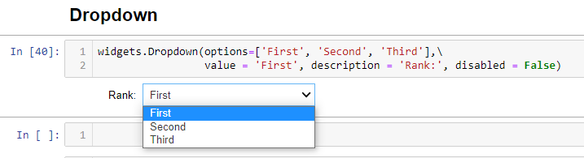
SelectionWidgets(CO4)
widgets.Dropdown() is one of the most prominently used Selection widgets under ipywidgets.
The parameters are mostly self explanatory.
In the options parameter, one passes a list of values that will appear in the dropdown.

Slide 38
The value parameter will be passed a value which the user wants to appear as selected by default. The description and disabled parameters serve the same purpose as in the previous widgets.
SelectionWidgets Contd…(CO4)
Select
widgets.Select
( options=['Linux', 'Windows', 'OSX'],
value='OSX',
# rows=10,
description='OS:', disabled=False
)

Slide 39
SelectionSlider widgets.SelectionSlider( options=['scrambled', 'sunny side up', 'poached', 'over easy'], value='sunny side up', description='I like my eggs ...', disabled=False, continuous_update=False, orientation='horizontal', readout=True )
SelectionWidgets Contd…(CO4)

Slide 40
SelectionRangeSlider import datetime dates = [datetime.date(2015,i,1) for i in range(1,13)] options = [(i.strftime('%b'), i) for i in dates] widgets.SelectionRangeSlider( options=options, index=(0,11), description='Months (2015)', disabled=False )
SelectionWidgets Contd…(CO4)

Slide 41
String widgets (CO4)
There are several widgets that can be used to display a string value. The Text, Textarea, and Combobox widgets accept input. The HTML and HTMLMath widgets display a string as HTML (HTMLMath also renders math). The Label widget can be used to construct a custom control label.
Text
TextArea
Combobox
Lable

Slide 42
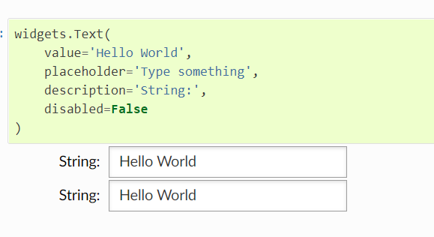
String widgets(Text) (CO4)

Slide 43
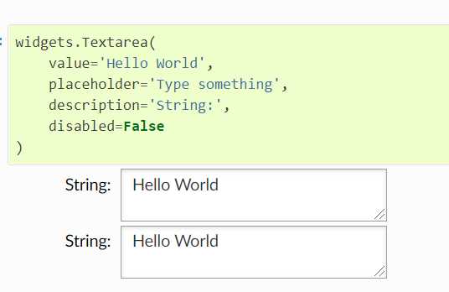
String widgets(Textarea) (CO4)

Slide 44
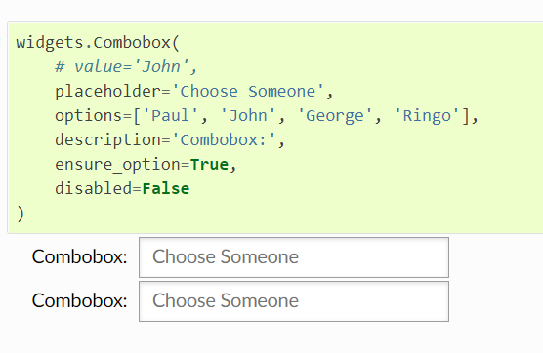
String widgets(Combobox) (CO4)

Slide 45
String widgets(Label) (CO4)
The Label widget is useful if you need to build a custom description next to a control using similar styling to the built-in control descriptions.

Slide 46
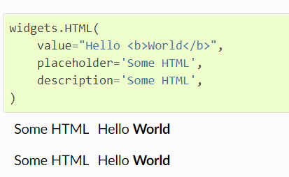
String widgets(HTML) (CO4)

Slide 47
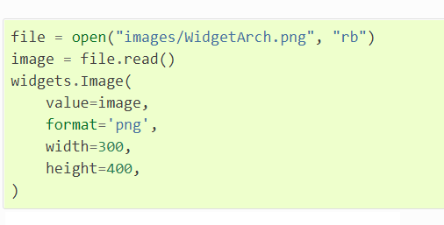
String widgets(Image) (CO4)

Slide 48
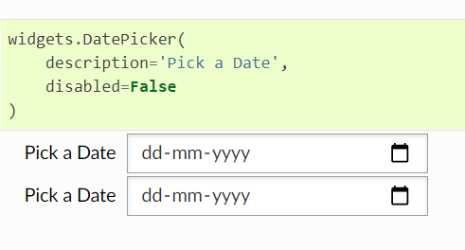
String widgets(Date picker) (CO4)
The date picker widget works in Chrome, Firefox and IE Edge, but does not currently work in Safari because it does not support the HTML date input field.

Slide 49
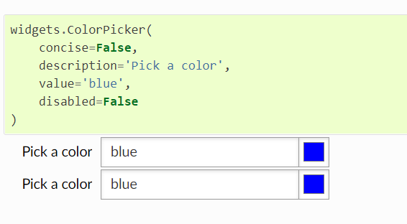
String widgets(Color picker) (CO4)

Slide 50
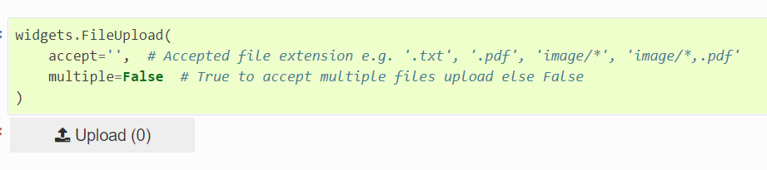
String widgets(File Upload) (CO4)
The File Upload allows to upload any type of file(s) into memory in the kernel.

Slide 51
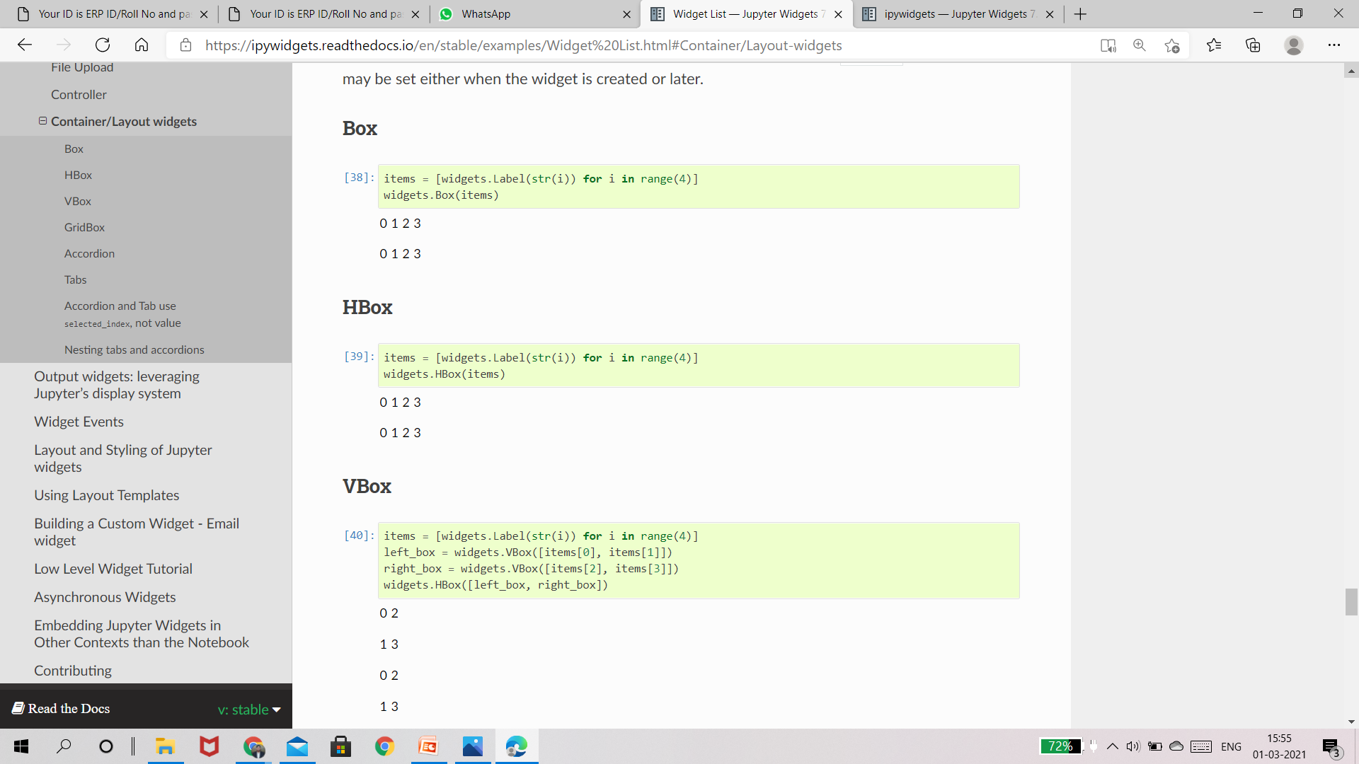

Container/Layout widgets(CO4)
These widgets are used to hold other widgets, called children.
Each has a children property that may be set either when the widget is created or later.

Slide 52
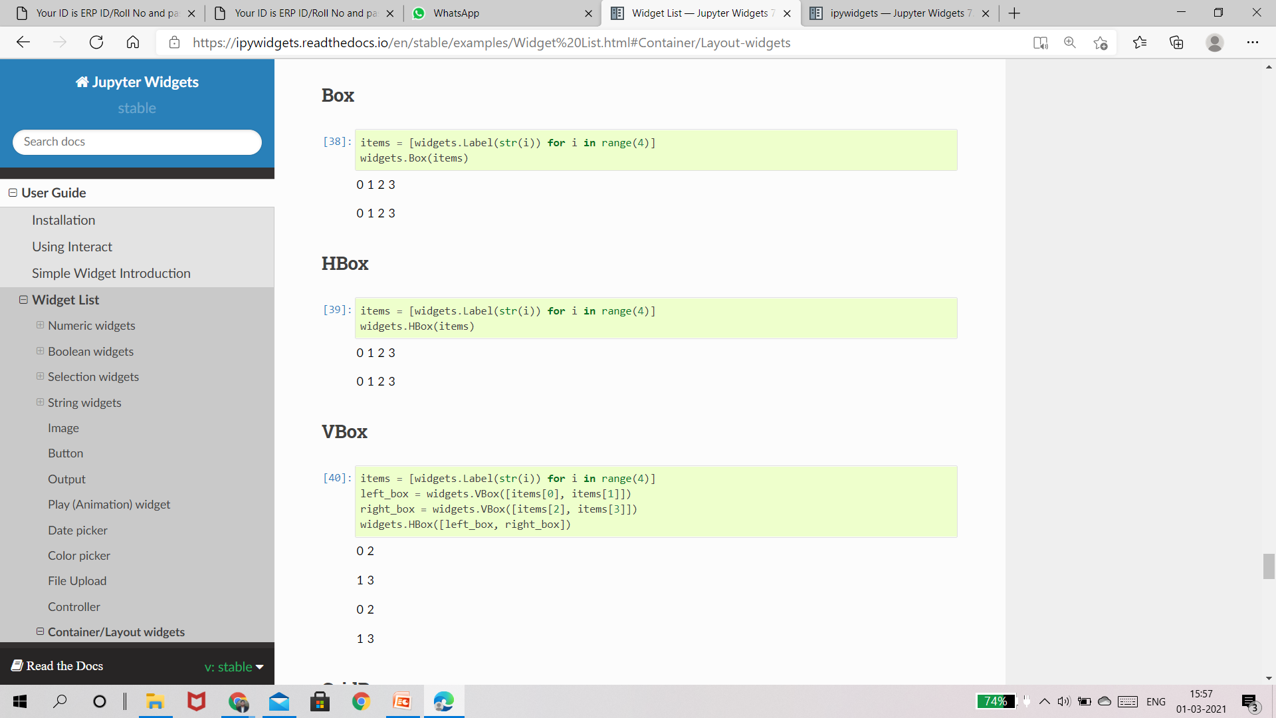
Container/Layout widgets(CO4)
These widgets are used to hold other widgets, called children.
Each has a children property that may be set either when the widget is created or later.

Slide 53
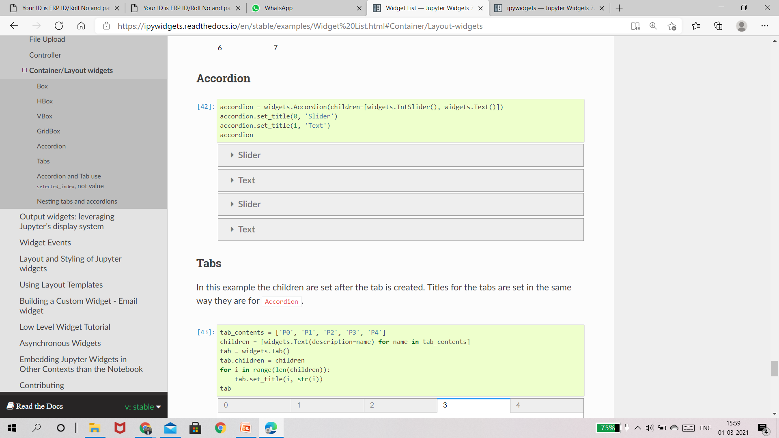
Container/Layout widgets(CO4)

Slide 54
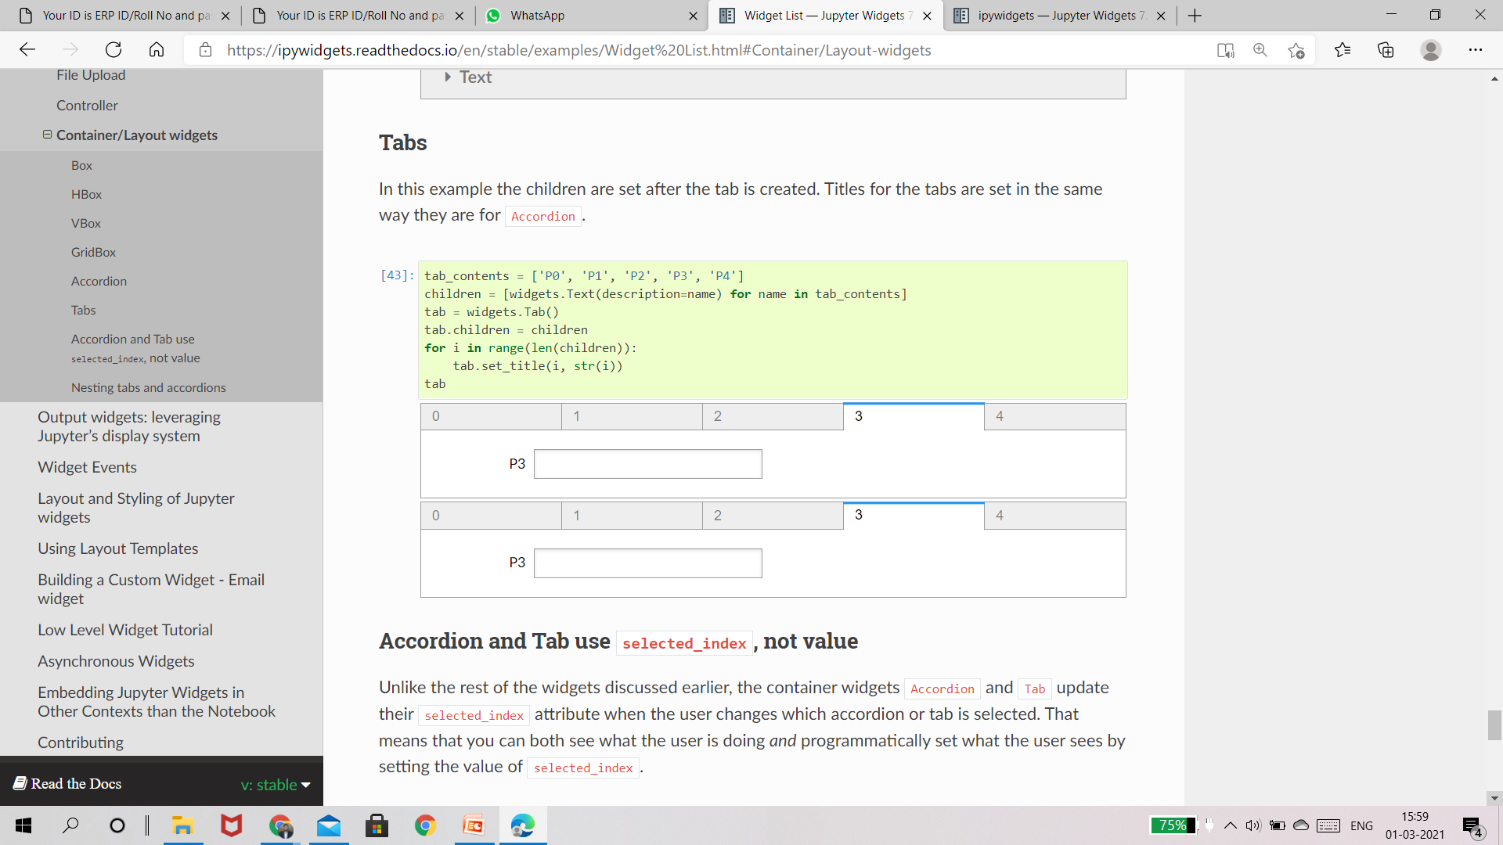
Container/Layout widgets(CO4)

Slide 55
Container/Layout widgets(CO4)

Slide 56
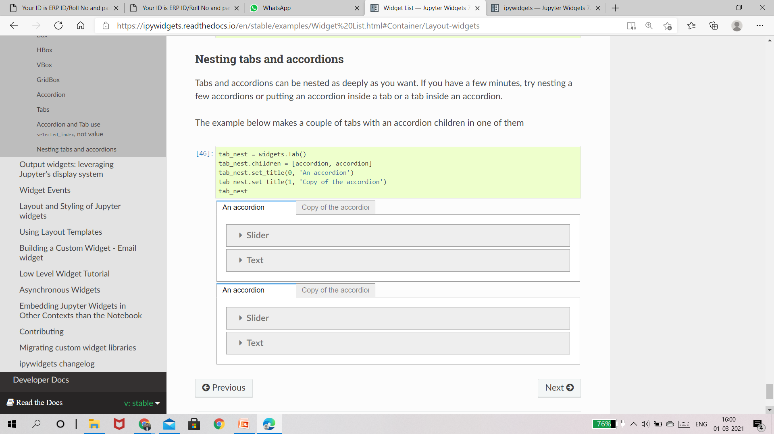
Container/Layout widgets(CO4)

Slide 57
MCQs
Ques1.Which of the following is clickable in GUI programming ?
(A) Button
(B) Checkbutton
(C) Lable
(D) 1 and 2
Ans D
Ques2.What we use to change the back ground color any widget ?
(A) background
(B) fg
(C) bg
(D) bground
Ans C

Slide 58
MCQs
Ques3.Essential thing to create a window screen using tkinter python?
(A) call tk() function
(B) create a button
(C) To define a geometry
(D) All of the above
Ans-A
Ques4.In which of the following field, we can put our Button?
(A) Window
(B) Frame
(C) Label
(D) All of the above
Ans-D

Slide 59
MCQs
Ques5.Minimum number of argument we pass in a function to create a rectangle using canvas tkinter ?
(A) 2
(B) 4
(C) 6
(D) 5
Ans-B
Ques6.Which of the following functions does not accept any arguments?
(A) position
(B) fillcolor
(C) goto
(D) setheading()
Ans -A

Slide 60
Introduction
We will learn how to create a tabbed widget interface by using Python GUI and Tkinter package.
The Tkinter module (“Tk interface”) is the standard Python interface to the Tk GUI toolkit. Both Tk and Tkinter are available on most Unix platforms, as well as on Windows systems. (Tk itself is not part of Python; it is maintained at ActiveState.)
Tkinter package is shipped with Python as a standard package, so we don’t need to install anything to use it.

Slide 61
Create First GUI Application using Python-Tkinter
Tkinter is lightweight and relatively painless to use compared to other frameworks.
This makes it a compelling choice for building GUI applications in Python, especially for applications where a modern shine is unnecessary, and the top priority is to build something that’s functional and cross-platform quickly.

Slide 62
Create First GUI Application using Python-Tkinter
Tkinter is a Python Package for creating GUI applications.
Python has a lot of GUI frameworks, but Tkinter is the only framework that’s built into the Python standard library.
Tkinter has several strengths; it’s cross-platform, so the same code works on Windows, macOS, and Linux.

Slide 63
Create First GUI Application using Python-Tkinter
1. Import tkinter package and all of its modules.
2. Create a root window. Give the root window a title(using title()) and dimension(using geometry()). All other widgets will be inside the root window.
3. Use mainloop() to call the endless loop of the window. If you forget to call this nothing will appear to the user. The window will wait for any user interaction till we close it.

Slide 64
Introduction to GUI With Tkinter in Python
Commonly comes bundled with Python, using Tk and is Python's standard GUI framework.
It is famous for its simplicity and graphical user interface.
It is open-source and available under the Python License.

Slide 65
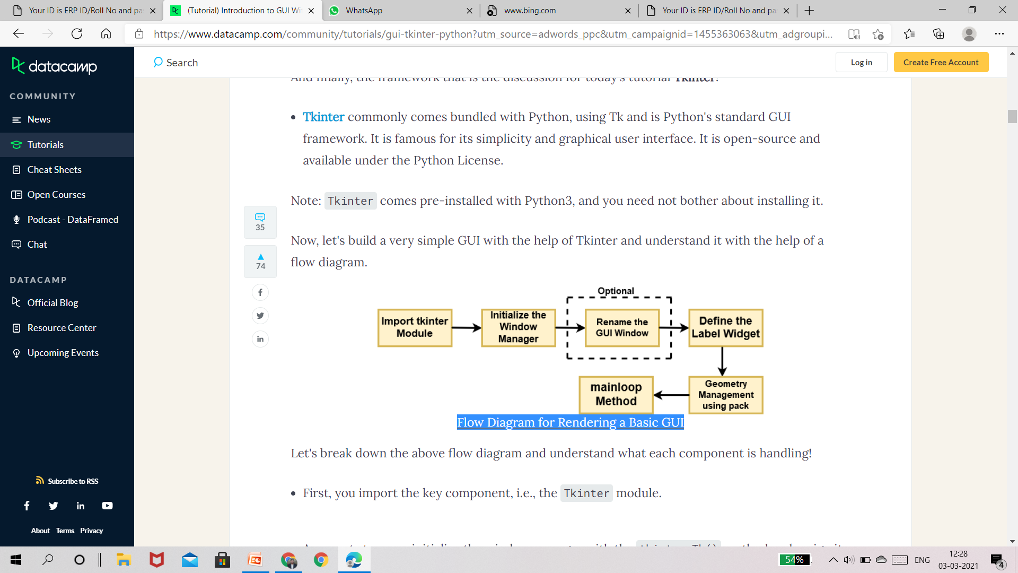
Flow Diagram for Rendering a Basic GUI

Slide 66
Flow Diagram for Rendering a Basic GUI
First, you import the key component, i.e., the Tkinter module.
As a next step, you initialize the window manager with the tkinter.Tk() method and assign it to a variable. This method creates a blank window with close, maximize, and minimize buttons on the top as a usual GUI should have.
Then as an optional step, you will Rename the title of the window as you like with window.title(title_of_the_window).

Slide 67
Flow Diagram for Rendering a Basic GUI
First, you import the key component, i.e., the Tkinter module.
As a next step, you initialize the window manager with the tkinter.Tk() method and assign it to a variable. This method creates a blank window with close, maximize, and minimize buttons on the top as a usual GUI should have.
Then as an optional step, you will Rename the title of the window as you like with window.title(title_of_the_window).

Slide 68
Widgets
Widgets are similar in spirit to elements in HTML.
You will find different types of widgets for different types of elements in the Tkinter.
They are standard GUI elements and provide the user with controls like buttons, text, menus, and text boxes

Slide 69
Button
Button widget has a property for switching on/off. When a user clicks the button, an event is triggered in the Tkinter.
Syntax: button_widget = tk.Button(widget, option=placeholder) where widget is the argument for the parent window/frame while option is a placeholder that can have various values like foreground & background color, font, command (for function call), image, height, and width of button.

Slide 70
Canvas
Canvas is used to draw shapes in your GUI and supports various drawing methods.
Syntax: canvas_widget = tk.Canvas(widget, option=placeholder) where widget is the parameter for the parent window/frame while option is a placeholder that can have various values like border-width, background color, height and width of widget.

Slide 71
Checkbutton:
Checkbutton records on-off or true-false state. It lets you can select more than one option at a time and even leave it unchecked.
Syntax: checkbutton_widget = tk.CheckButton(widget, option=placeholder) where widget is the parameter for the parent window/frame while option is a placeholder that can have various values like title, text, background & foreground color while widget is under the cursor, font, image, etc.

Slide 72
Entry
Entry widget is used to create input fields or to get input text from the user within the GUI.
Syntax: entry_widget = tk.Entry(widget, option=placeholder) where widget is the parameter for the parent window/frame while option is a placeholder that can have various values like border-width, background color, width & height of button etc.

Slide 73
Frame
Frame is used as containers in the Tkinter for grouping and adequately organizing the widgets.
Syntax: frame_widget = tk.Frame(widget, option=placeholder) where widget is the parameter for the parent window/frame while option is a placeholder that can have various values like border-width, height & width of widget, highlightcolor (color when widget has to be focused).

Slide 74
Label
Label is used to create a single line widgets like text, images, etc.
Syntax: label_widget = tk.Label(widget, option=placeholder) where widget is the parameter for the parent window/frame while option is a placeholder that can have various values like the font of a button, background color, image, width, and height of button.

Slide 75
Tkinter provides you with three main geometry manager classes:
pack(): It organizes the widgets in a block manner, and the complete available width is occupied by it. It's a conventional method to show the widgets in the window.
grid(): It organizes the widgets in a table-like structure. You will learn about it in detail later in this tutorial.
place(): Its purpose is to place the widgets at a specific position as instructed by the user in the parent widget.

Slide 76
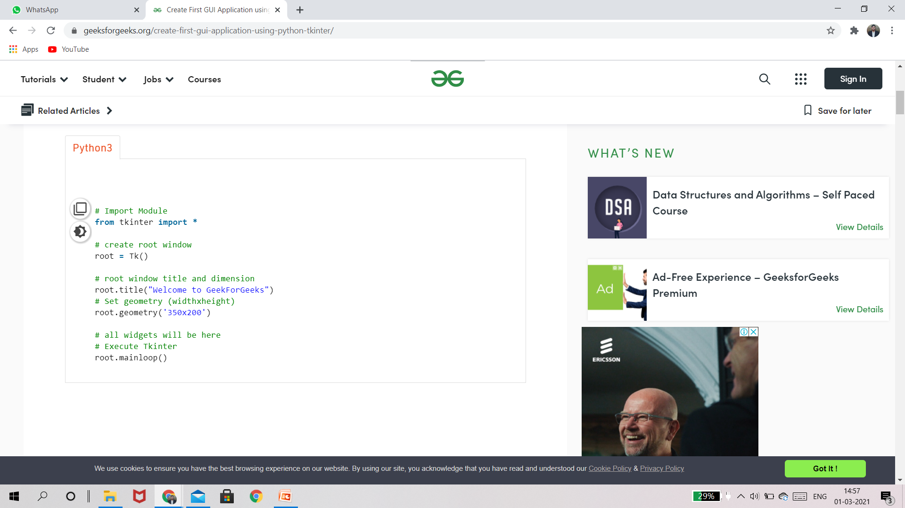
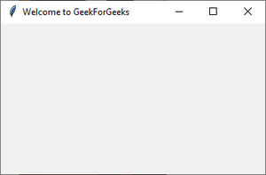
Create First GUI Application using Python-Tkinter

Slide 77
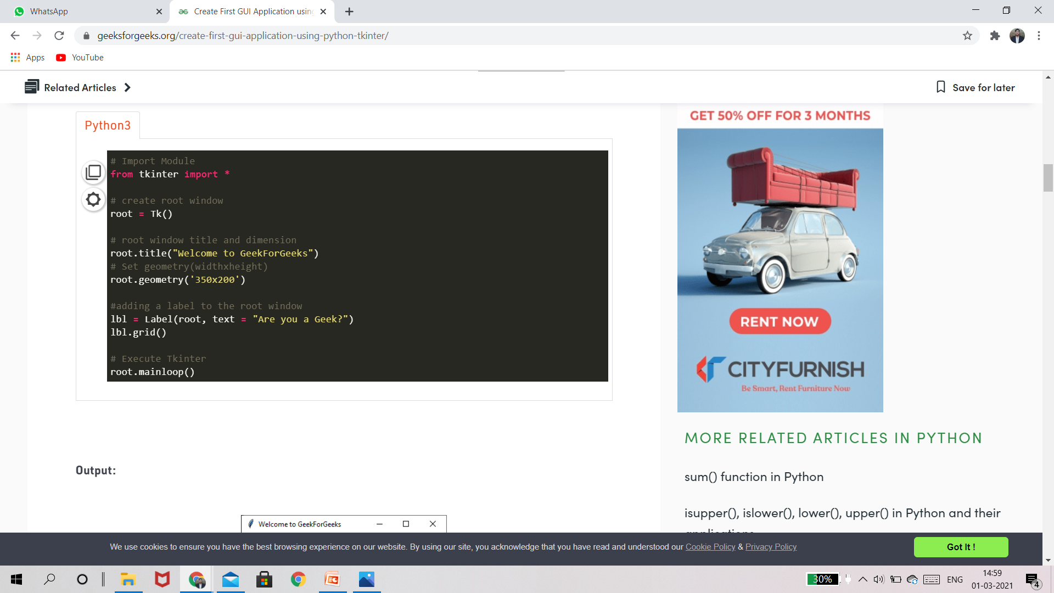
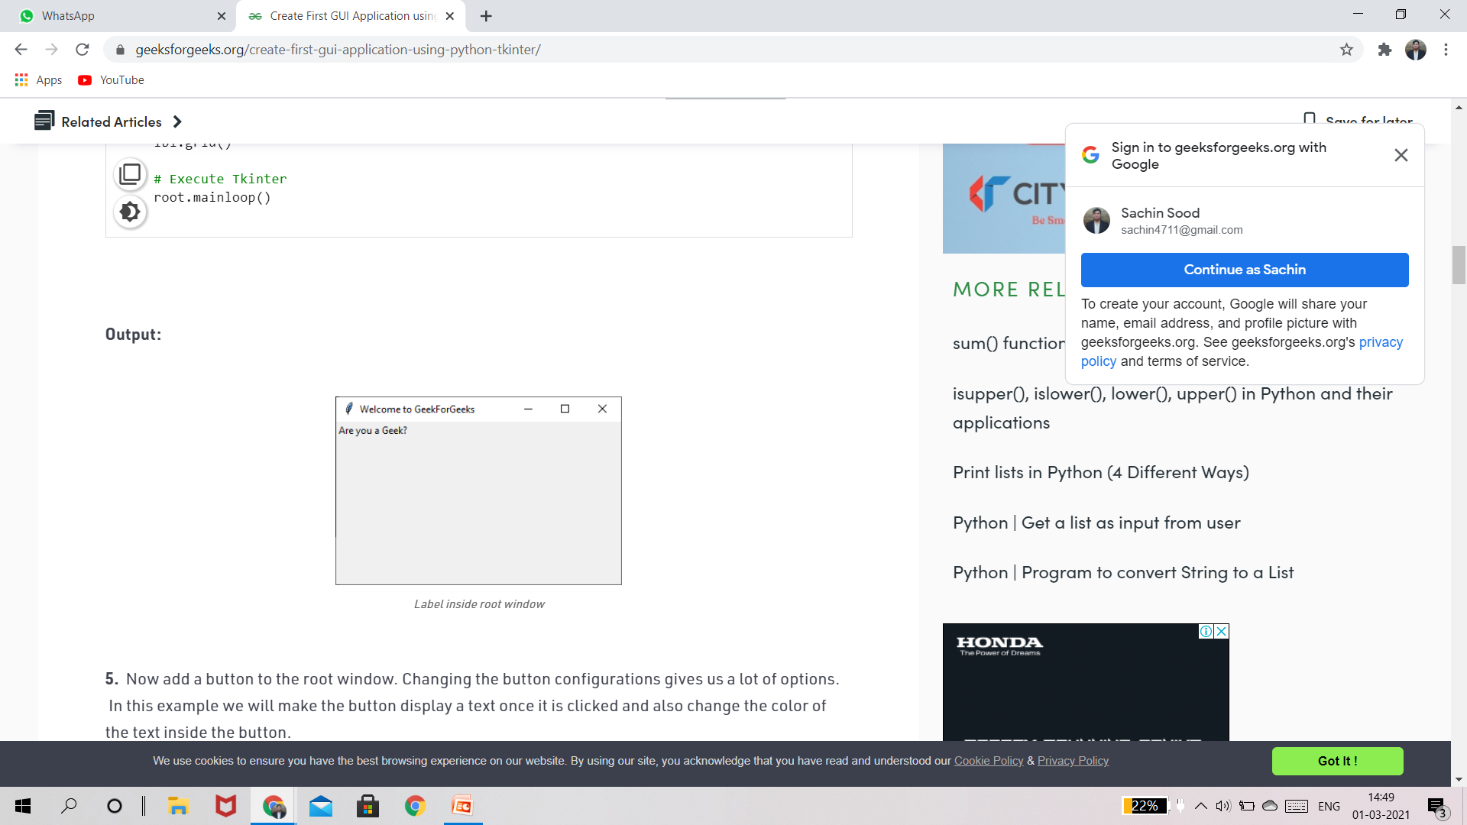
4. We’ll add a label using the Label Class and change its text configuration as desired. The grid() function is a geometry manager which keeps the label in the desired location inside the window. If no parameters are mentioned by default it will place it in the empty cell; that is 0,0 as that is the first location.
Ouput

Slide 78
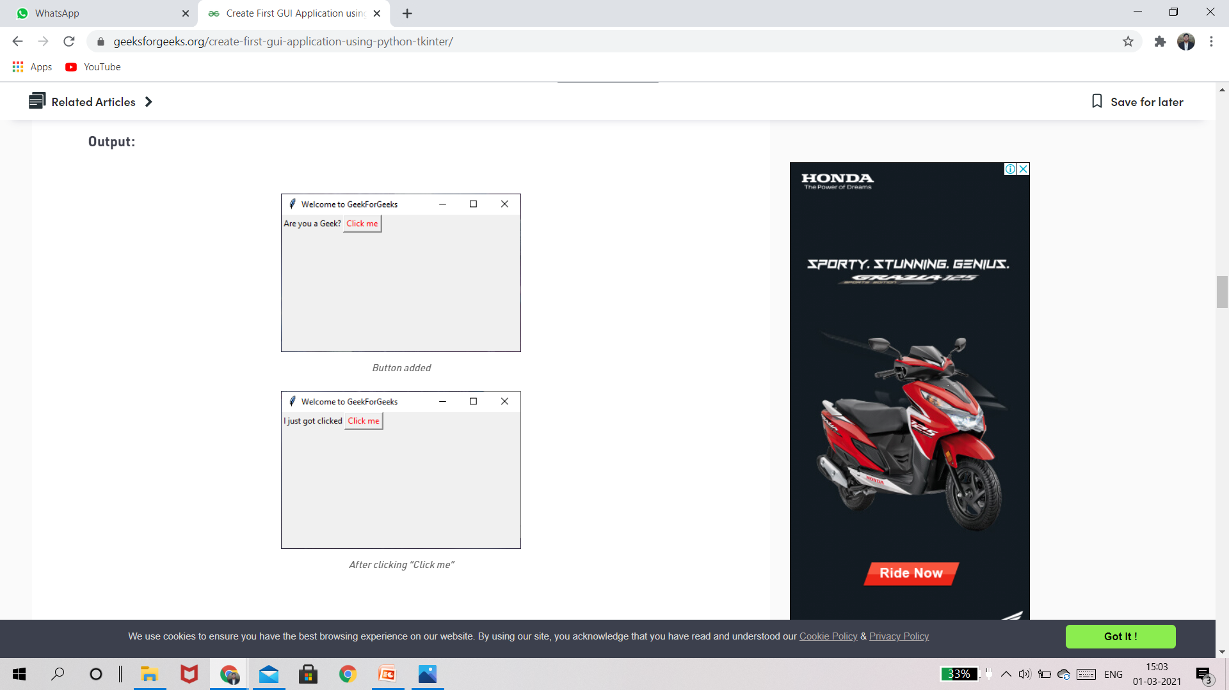
5.Now add a button to the root window. Changing the button configurations gives us a lot of options. In this example we will make the button display a text once it is clicked and also change the color of the text inside the button.

Slide 79
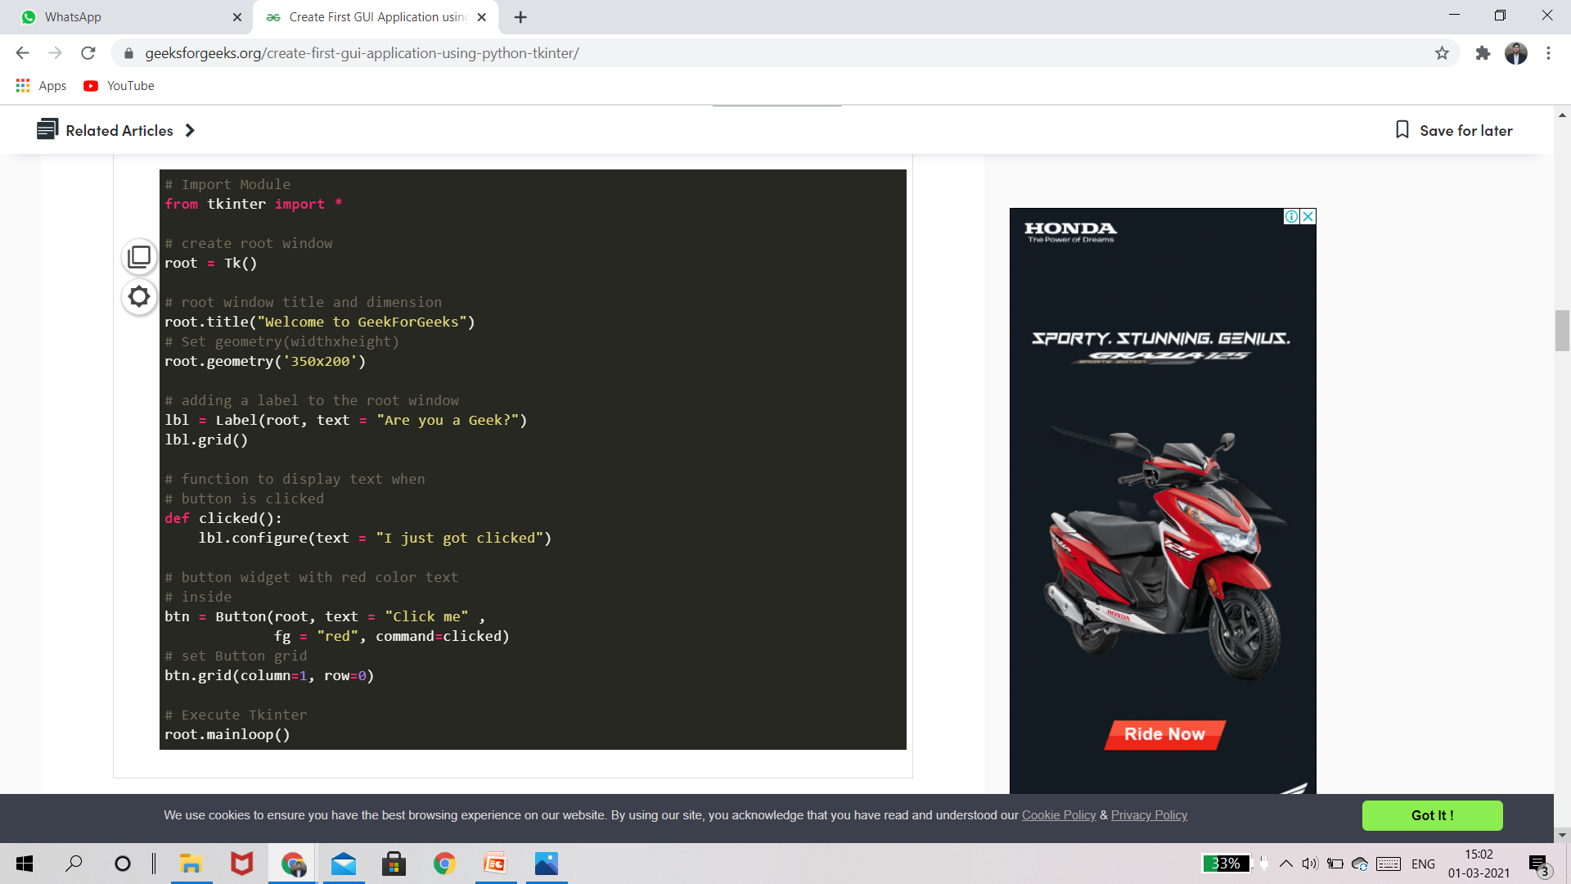
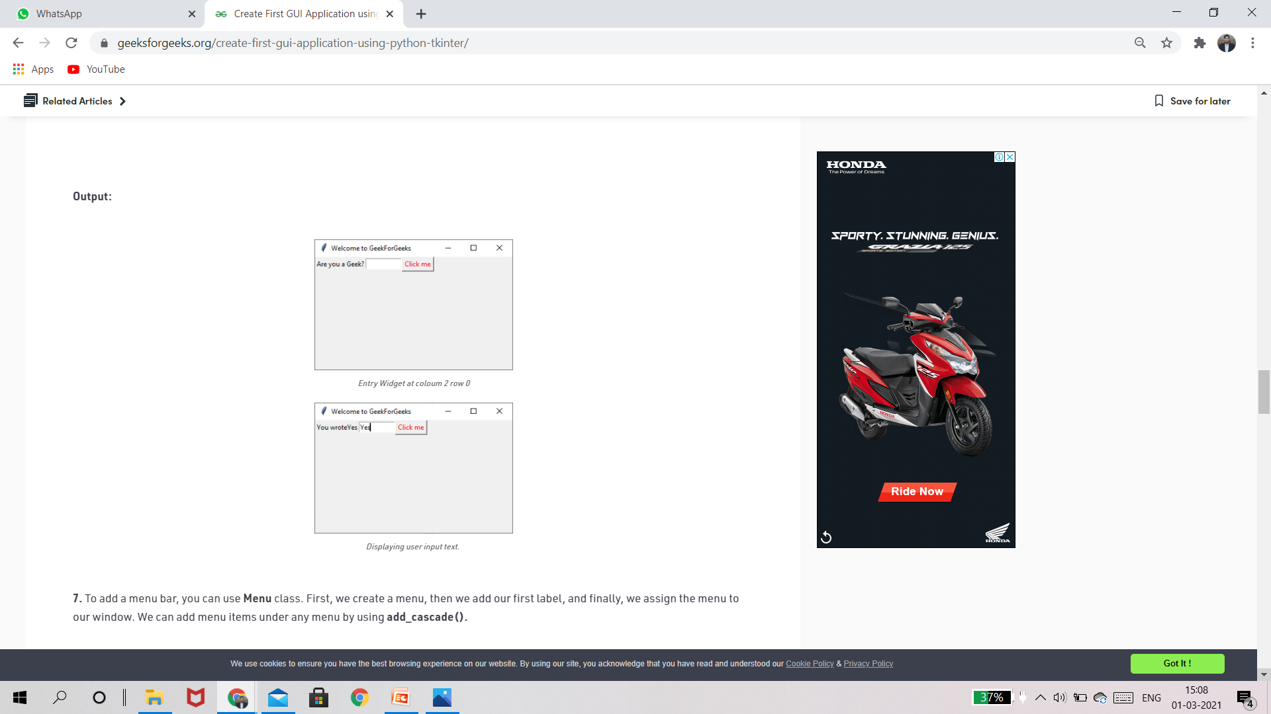
6. Using the Entry() class we will create a text box for user input. To display the user input text, we’ll make changes to the function clicked(). We can get the user entered text using the get() function. When the Button after entering of the text, a default text concatenated with the user text. Also change button grid location to column 2 as Entry() will be column 1.
Output:

Slide 80
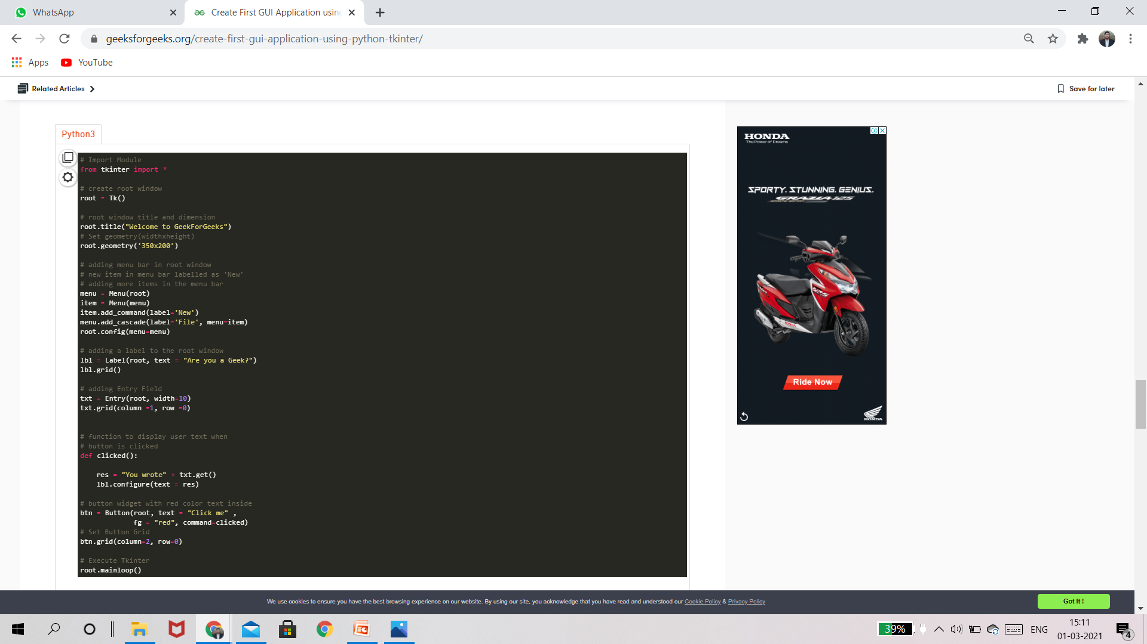
7. To add a menu bar, you can use Menu class. First, we create a menu, then we add our first label, and finally, we assign the menu to our window. We can add menu items under any menu by using add_cascade().

Slide 81
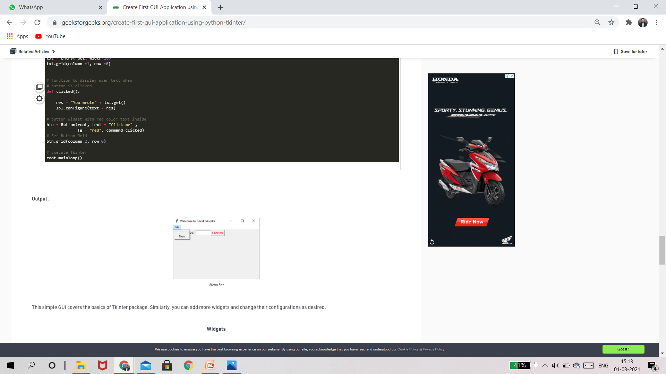
Output:

Slide 82
Creating a Calculator with Tkinter
https://www.datacamp.com/community/tutorials/gui-tkinter-python

Slide 83
Daily Quiz
Ques1.Config() in Python Tkinter are used for
1.destroy the widget
2.place the widget
3.change property of the widget
4.configure the widget
Ques2.GUI stands for?
Ques3. fg in tkinter widget is stands for ?
*

Slide 84
Weekly Assignment
Config() in Python Tkinter are used for
Correct way to draw a line in canvas tkinter ?
Creating line are come in which type of thing ?
Essential thing to create a window screen using tkinter python?
fg in tkinter widget is stands for ?
For user Entry data, which widget we use in tkinter ?
For what purpose, the bg is used in Tkinter widget ?
From which keyword we import the Tkinter in program?
How pack() function works on tkinter widget ?
How the grid() function put the widget on the screen ?

Slide 85
MCQs
Ques1. Correct way to draw a line in canvas tkinter ?
1.line()
2.canvas.create_line()
3.create_line(canvas)
4.None of the above
Ques2.Essential thing to create a window screen using tkinter python?
1.call tk() function
2.create a button
3.To define a geometry
4.All of the above

Slide 86
MCQs
Ques3. fg in tkinter widget is stands for ?
1.foreground
2.background
3.forgap
4.None of the above
Ques4. For user Entry data, which widget we use in tkinter ?
1.Entry
2.Text
3.Both of the above
4.None of the above

Slide 87
MCQs
Ques5.For what purpose, the bg is used in Tkinter widget ?
To change the direction of widget
To change the size of widget
To change the color of widget
To change the background of widget
Ques6.From which keyword we import the Tkinter in program?
call
from
import
All of the above

Slide 88
MCQs
Ques7. How the place() function put the widget on the screen ?
1.According to x,y coordinate
2.According to row and column vise
3.According to left,right,up,down
4.None of the above
Ques8.How we import a tkinter in python program ?
1.import tkinter
2.import tkinter as t
3.from tkinter import *
4.All of the above

Slide 89
MCQs
Ques9.It is possible to draw a circle directly in Tkinter canvas ?
1.Yes
2.No
3.No(but possible by oval)
4.None of the above
Ques10. Minimum number of argument we pass in a function to create a rectangle using canvas tkinter ?
2
4
6
5

Slide 90
Summary
My GUI Programming Cheatsheet | Python3 | Jupyter | by Shivam Dutt Sharma | Analytics Vidhya | Medium
https://ipywidgets.readthedocs.io/en/stable/examples/Widget%20List.html
https://www.edureka.co/blog/tkinter-tutorial/

Slide 91
Thank You

